Slide 1

BRAINS Board: Programmable Single and Multi Channel Neurostimulation Device
Eashan Sahai – Denman Lab
CU Anschutz NeuroEngineering Mini Symposium
04/29/2024

Slide 2
Background

Slide 3
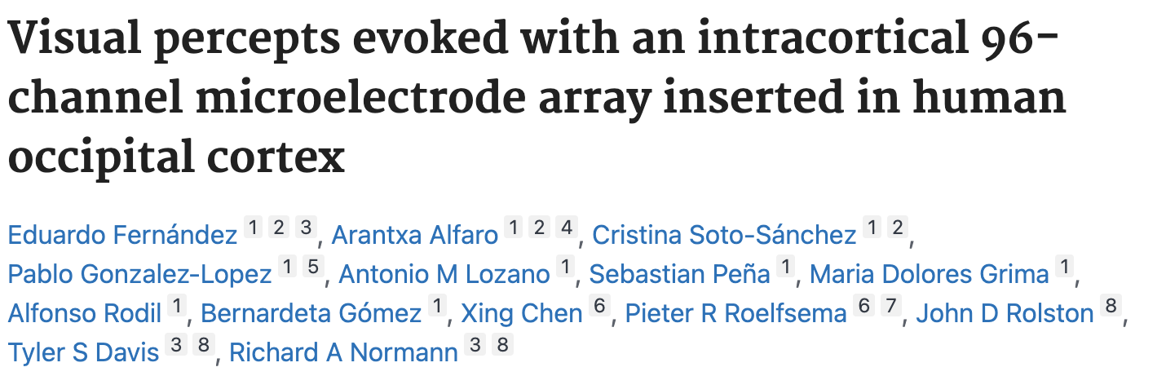
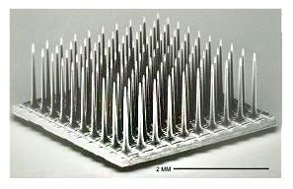
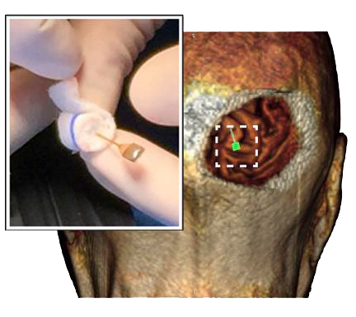
Background: Clinical Electrical Brain Stimulation
Current clinical uses
Movement disorders
Epilepsy
Mental health disorders
Notes:
EBS has been at the forefront of many sought after clinical trials. And right now, the technology for EBS has a lot of capabilities, including allowing for multiple stimulation sites in clinical side. BCI studies have explored using multichannel stimulation for all sorts of purposes, but we don’t fully understand the biophysics of stimulating from single and multiple sites.
What did I mean?: Improving EBS through parameter space.

Slide 4
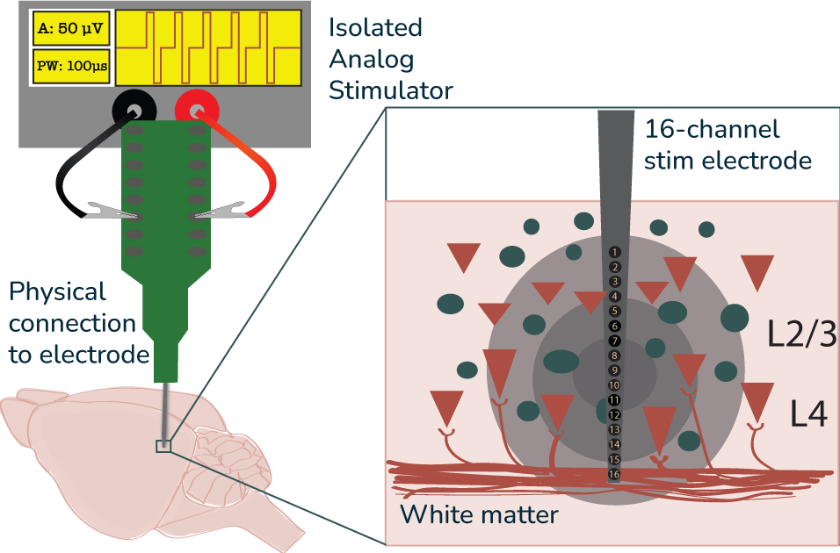
Background: Basic Biophysics
Perform experiments in the mouse visual cortex
Single Channel Stimulation
1 Cathode 1 Anode
Variable waveforms, amplitudes, and pulse widths
Issues:
Inefficient Channel Switching
Physical Manipulation required
Varied multichannel stimulation is difficult
Adapted from Jordan Hickman – Denman Lab
Notes:
Key takeaway: We aren’t getting as much as we can from our current setup.

Slide 5
HOW DO WE Perform multichannel stimulation?

Slide 6
HOW DO WE Perform multichannel stimulation?
Switches!
Notes:
SWITCHES!

Slide 7
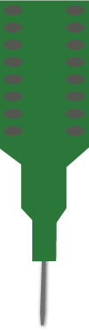
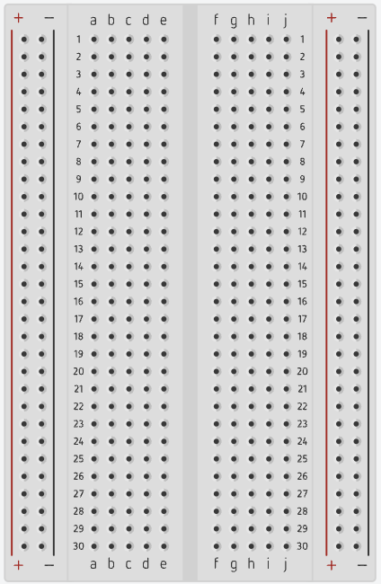
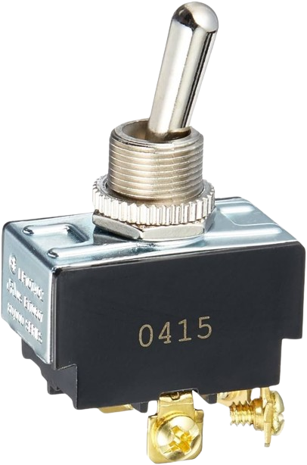
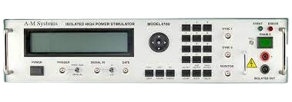
Potential Solution #1: Physical 3-STATE Switch
Physical 3 State Switch for CATHODE, GROUND, AND ANODE THAT CAN BE SWITCHED PHYSICALLY
BENEFITS | DOWNFALLS
Minimal electrical interference | Can’t quickly switch channels
Inexpensive | Physical manipulation required
x16
Notes:
Keep this short. Points:
Thesis: A solution is a 3 State Switch for the 3 potential type of contact we want our electrode to be in
On the plus side, its easy and doesn’t interfere electrically
But it requires a person and won’t work if precise timing is required
When trying to understand EBS, we are going to want temporal specificity which cannot be achieved with this!

Slide 8
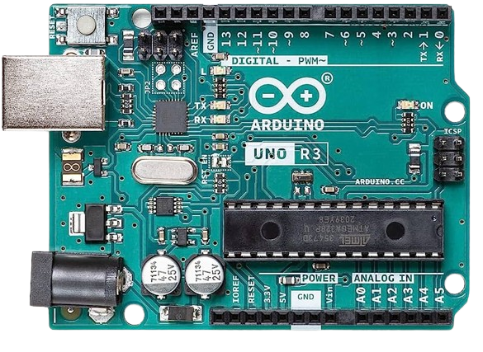
Potential Solution #2: Electrical Switch
Programmable Electrical Switch that utilizes software and electronic hardware to select channels
BENEFITS | DOWNFALLS
Easy to use | Risk of electrical interference
Serve multipurpose tasks | Difficult due to highly varied voltages (in-brain resistivity)
?
Notes:
Thesis: A better solution is an electrical switch, which gives us temporal specificity and allows for connectivity with other electronic devices used in the experiment (ie.
laser or data acquisition system), but this would only work if we can ensure that the signal from our stimulator makes it to the stimulating electrode with
negligible noise or signal loss
? - Add physical vs. electrical demonstration

Slide 9
Can we programmatically select stimulation channels to deliver Isolated stimulation from multiple contacts and achieve multipolarity?

Slide 10
Design objectives:
1. Limit interference between our microcontroller and the signal sent from our stimulator to the stimulating electrode
Notes:
We don’t want to see any significant loss of signal or significant noise compared to baseline.

Slide 11
Design objectives:
1. Limit interference between our microcontroller and the signal sent from our stimulator to the stimulating electrode
2. Quickly choose and change which signal (Cathode, Anode, Grounded, or Floating) each stimulating electrode receives
Notes:
We need to ensure that we can reduce the amount of delay between when we receive information/signal to change the channel and when the signal is
properly directed to each channel.

Slide 12
Design objectives:
1. Limit interference between our microcontroller and the signal sent from our stimulator to the stimulating electrode
2. Quickly choose and change which signal (Cathode, Anode, Grounded, or Floating) each stimulating electrode receives
3. Reduce number of pins a programmable microcontroller uses to switch channels

Slide 13
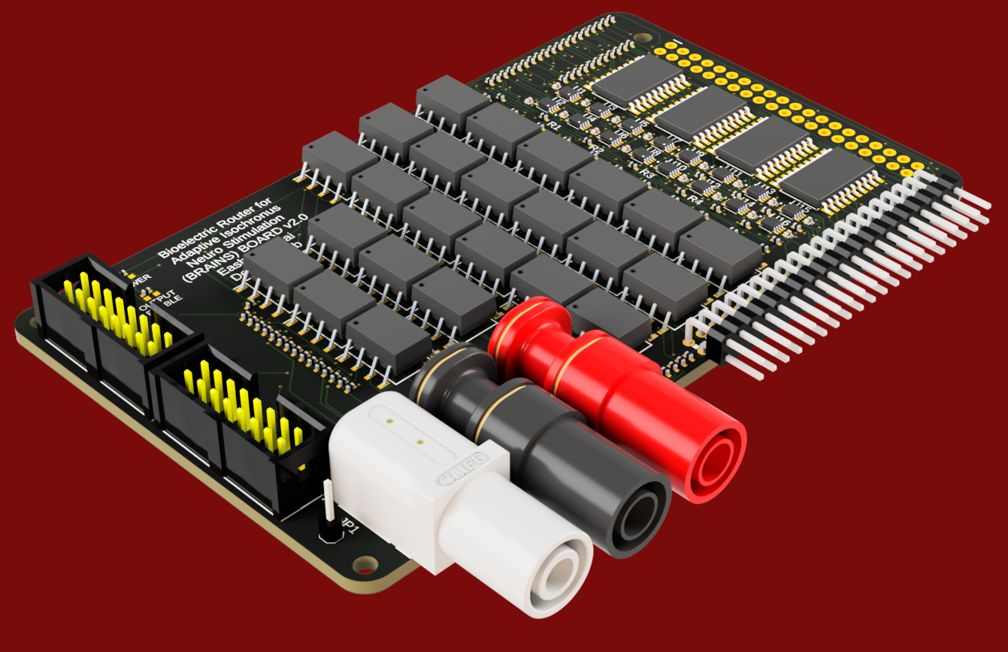
Bioelectric Router For adaptive isochronous neuro stimulation (BRAINS) Board
Version 2.0
Notes:
This is a proprietary board that I designed to be able to programmatically stimulate a 16 channel electrode with the capability of single and multichannel stimulation
in any configuration on a 16 channel electrode array using only connection to a microcontroller.
Just for if anyone asks:
$631.70 + $400.00 for stencil & setup
Note: Produced by local producer, not mass manufacturing companies in China

Slide 14
Objective 1. Limit interference between our microcontroller and the signal sent from our stimulator to the stimulating electrode

Slide 15
Solution 1: Solid State relays (SSR)
SOLID STATE RELAY
SSRs optically isolate signal from one side to another
Currently used in many Analog Isolators for medical applications
CATHODE (Stim)
OPTICAL RECIEVER AND
SWITCH
LED
ANODE (Stim)
OPTICAL RECIEVER AND
SWITCH
LED
CHANNEL
OUTPUT
(SIGNAL GROUND)
OPTICAL RECIEVER AND
SWITCH
CONTROL | STATE
L(0) or float | OFF
H(1) | ON
LED
Notes:
Solid State relays use optical isolators, which act as switches that change states using an LED and a photo-voltaic diode, which allows the diode to act as its own little
switch to close the circuit without any direct conduction side between either side of the board. So we can choose our channels and send a 5V signal to any
channel to turn it on by powering the LED and if we want to turn it off, we just stop delivering 5V.

Slide 16
Objective 2. Quickly choose and change which signal (Cathode, Anode, Grounded, or Floating) each stimulating electrode receives

Slide 17
Solution 2: Sp3T Switches
5V
SOLID STATE RELAY
CATHODE
Logic Control
ANODE
SP3T
S1 | S2 | STATE
L | L | FLOAT
H | L | CATHODE
L | H | ANODE
H | H | SGND
SGND
(SIGNAL GROUND)
S1
S2
X16
Notes:
SP3T Switches are designed to receive 2 programmable inputs along with 5V power, and using the state of the two inputs will allow a 4 state logic.
Base state, when everything is off, is the floating state where no signal is sent, then if only Switch 1 on, we send the input 5V to power our resistor on the Cathode
Solid state relay, if only switch 2 is on then same thing but with the anode, and if both are on then for our signal ground. Easy way to ensure that only one state
Is active per channel, and has negligible delay in signal travelling and the temporal precision that is only dependent on the microcontroller sending the signal.
Speaking of the microcontroller…

Slide 18
Objective 3. Reduce number of pins a programmable microcontroller uses to switch channels

Slide 19



Solution 3.1: Octal Latches
10 signals in 8 signals out
When latch enable on, we can change state of the 8 signals, else latched to previous signal chosen
If we set up 4 of these, we only need 1 OE, 4 LE, and 8 D pins to control 6 channels
This also helps with scalability
Equation:
D1
S1
D2
S2
D3
S3
D4
S4
D5
S5
D6
S6
D7
S7
D8
S8
Latch Enable (LE)
Output Enable (OE)
Output Enable | Latch Enable | D{X} | S{X}
H | ---- | ---- | Z (float)
L | L | ---- | Q_{t-1}
L | H | L | L
L | H | H | H
$$\left(\frac{2 Output Signals × \# of Electrode Channels}{8}\right)$$
$$\# of$$
$$Latches$$
$$=$$
Notes:
A solution is multiplexing using octal latches. It may seem like a lot here because there’s 10 signals in and 8 signals out. Well, what if I told you that if we added a second one of these, we would only need to add one more pin to have 8 more outputs. And if I added one more, we only need 1 pin to add 8 more. This is called multiplexing. We start with 1 Output Enable pin that we connect to every single one of our OEs, just so we can enable or disable sending any output from this to our SP3T. Then we have our 8 input pins to change our signal output, and those are pretty much 1 to 1 except for the caveat that it only works when the latch enable is on. That leads us to the latch enable pin, which we only turn on when we want to change the state of our output for a given set of 8 outputs. When the latch enable is disconnected, the octal latch continues to send that signal until the next time the latch enable is connected or output enable stops it. Therefore, since we need 16 sets of S1 and S2, we can use the bottom equation to determine quite easily that we need 4 octal latches.

Slide 20


Solution 3.1: Octal Latches
10 signals in 8 signals out
When latch enable on, we can change state of the 8 signals, else latched to previous signal chosen
If we set up 4 of these, we only need 1 OE, 4 LE, and 8 D pins to control 6 channels
This also helps with scalability
Equation:
D1
S1
D2
S2
D3
S3
D4
S4
D5
S5
D6
S6
D7
S7
D8
S8
Latch Enable (LE)
Output Enable (OE)
Output Enable | Latch Enable | D{X} | S{X}
H | ---- | ---- | Z (float)
L | L | ---- | Q_{t-1}
L | H | L | L
L | H | H | H
$$\left(\frac{2 Output Signals × \# of Electrode Channels}{8}\right)$$
$$\# of$$
$$Pins$$
$$=$$
$$+ 8 Signal In Pins+1 OE Pin$$
Notes:
4 octal latches means 4 LE Pins, which if we add in our 8 signal pins and 1 oe pin, we only use 13 pins to send 32 unique output signals at any given time. 13 pins is awesome, because…

Slide 21
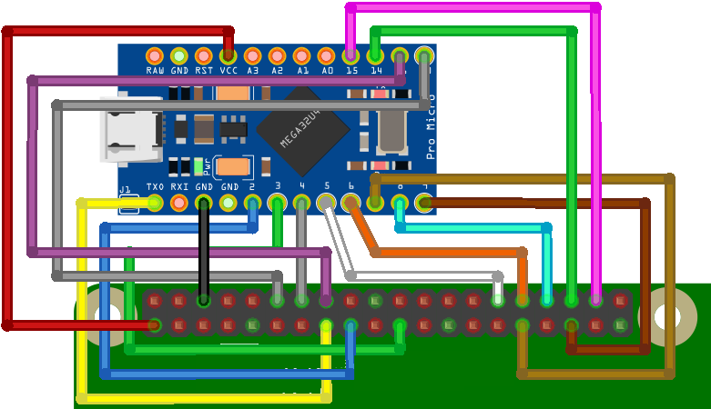
Solution 3.2: Connection to Raspberry pi/Arduino
Arduino API:
Channel Selector
Channel State
Apply Settings
Wait for External Trigger (Pin A0)
Set Delay Time
Optional Loop Count
Notes:
The Arduino micro and uno have at least 13 digital pins, so does the raspberry pi or really any entry level microcontroller.
I designed an open source api for raspberry pi, Arduino, and python through Arduino serial read. And, because you can connect any microcontroller, it is easy to make your own.
My api is designed with customizability in mind, allowing for any configuration of states that channels are and both externally and internally triggered delays and looping options
So that any single and multichannel configuration is possible for a 16 channel electrode.

Slide 22
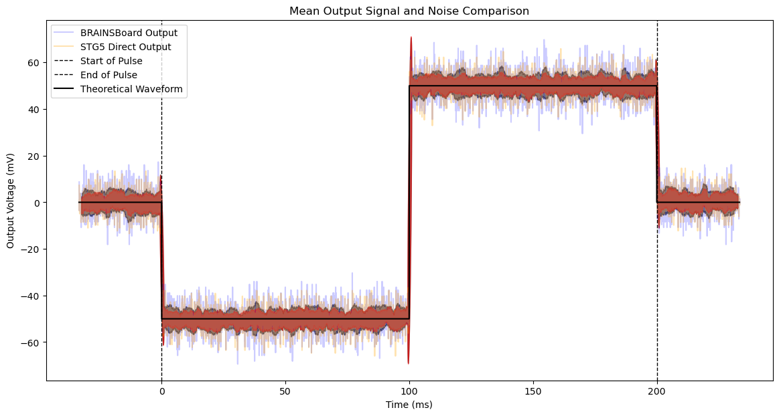
RESULTS 1: Limiting Interference
 | RMSE | MAE | Pearson Correlation Coefficient | SNR | Stdev
Direct STG5 Signal | 43.24 mV | 37.44 mV | 0.99 | 0.01 dB | 43.24 mV
STG5 Signal via BRAINSBoard | 43.24 mV | 37.44 mV | 0.99 | 0.01 dB | 43.24 mV
Notes:
Root Mean Squared Error (RMSE)and Mean Absolute Error (MAE) signal to noise (SNR) and Standard deviation stdev, pearson correlation coefficient

Slide 23
RESULTS 2: Quickly choose and change Signal
Pulse Width:
1 ms
Pulse Width:
1 ms
Channel 1: Cathode
Channel 2: Anode
Channel 3: Cathode
Channel 4: Anode
Amplitude:
50 mV
Delay Between Switching:
100 us
Notes:
Root Mean Squared Error (RMSE)and Mean Absolute Error (MAE) signal to noise (SNR) and Standard deviation stdev, pearson correlation coefficient

Slide 24
Results 2: Quickly choose and change Signal
The average time of signal in Channel 1(C) and 2(A) is 1.675 (ms)
The average time of signal in Channel 5(C) and 6(A) is 1.568 (ms)
The average time to switch between each Channel is 189.474 (us)
Expected Signal Length is 1 (ms)

Slide 25
Acknowledgements
Denman Lab
Daniel Denman, PhD
Jordan Hickman
Juan Santiago
Kim Gagnon
Nicholas Garcia
Michelle Near
Moriah Miles
Former Members:
Grant Hughes
Elena Esch
Isabelle Hua
University of Colorado Anschutz Medical Campus

Slide 26
Thank you for Listening! Questions?

Slide 27
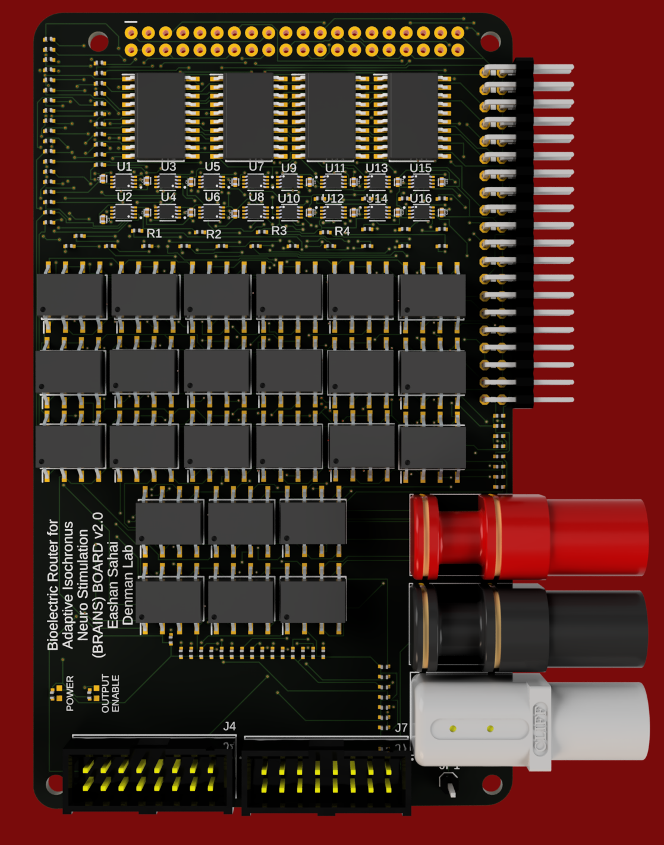
The BRAINS BOARD
1. Connectors to Raspberry Pi/Arduino and External Pins
2. Connectors to the electrode
3. Banana Connectors to our cathode and anode pulses from the Isolated Analog Power Stimulator and ground connection
4. Octal Transparent D-Type Latch with 3-State Output
5. Analog SP3T Switch
6. Solid State Relays

Slide 28
The BRAINS BOARD
1. Connectors to Raspberry Pi/Arduino and External Pins
2. Connectors to the electrode
3. Banana Connectors to our cathode and anode pulses from the Isolated Analog Power Stimulator and ground connection
4. Octal Transparent D-Type Latch with 3-State Output
5. Analog SP3T Switch
6. Solid State Relays

Slide 29
Roadmap
Background
Clinical EBS
Basic Biophysics EBS
Multichannel Stimulation Attempt

Slide 30
The BRAINS BOARD
1. Connectors to Raspberry Pi/Arduino and External Pins
2. Connectors to the electrode
3. Banana Connectors to our cathode and anode pulses from the Isolated Analog Power Stimulator and ground connection
4. Octal Transparent D-Type Latch with 3-State Output
5. Analog SP3T Switch
6. Solid State Relays

Slide 31
The BRAINS BOARD
1. Connectors to Raspberry Pi/Arduino and External Pins
2. Connectors to the electrode
3. Banana Connectors to our cathode and anode pulses from the Isolated Analog Power Stimulator and ground connection
4. Octal Transparent D-Type Latch with 3-State Output
5. Analog SP3T Switch
6. Solid State Relays

Slide 32
The BRAINS BOARD
1. Connectors to Raspberry Pi/Arduino and External Pins
2. Connectors to the electrode
3. Banana Connectors to our cathode and anode pulses from the Isolated Analog Power Stimulator and ground connection
4. Octal Transparent D-Type Latch with 3-State Output
5. Analog SP3T Switch
6. Solid State Relays

Slide 33
The BRAINS BOARD
1. Connectors to Raspberry Pi/Arduino and External Pins
2. Connectors to the electrode
3. Banana Connectors to our cathode and anode pulses from the Isolated Analog Power Stimulator and ground connection
4. Octal Transparent D-Type Latch with 3-State Output
5. Analog SP3T Switch
6. Solid State Relays

Slide 34
The BRAINS BOARD
1. Connectors to Raspberry Pi/Arduino and External Pins
2. Connectors to the electrode
3. Banana Connectors to our cathode and anode pulses from the Isolated Analog Power Stimulator and ground connection
4. Octal Transparent D-Type Latch with 3-State Output
5. Analog SP3T Switch
6. Solid State Relays

Slide 35
The BRAINS BOARD
BENEFITS:
Allows for modularity
Can be used in conjunction with any stimulator
Universal Box headers can be soldered to any connector to e-stim
Easily Scalable
Multiple Grounding Sites

Slide 36
The BRAINS BOARD
Multiple Signal Ground Pins to reduce board noise
Solid State Relays also reduce Board Noise
Relatively Inexpensive

Slide 37
Brains Board
This board covers all these concerns and does everything we ask.

Slide 38
QUESTION 3: ADDITIONAL QUESTIONS
How do we switch a channel to a signal and leave in in that state until we want to change it?
We want the logic of S1 and S2 to be “latched” into place when we set it until we want to change it
How do we use as few pins on our board as possible?
The answer is called “signal multiplexing”

Slide 39
QUESTION 3: ADDITIONAL QUESTIONS
How do we switch a channel to a signal and leave in in that state until we want to change it?
We want the logic of S1 and S2 to be “latched” into place when we set it until we want to change it
How do we use as few pins on our board as possible?
The answer is called “signal multiplexing”

Slide 40
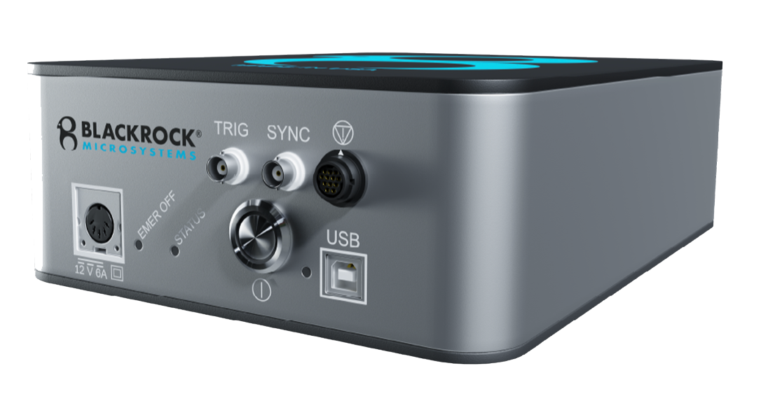
OTHER SOLUTIONS - UTAH Electrode Array with CereStim™ R96
CereStim™ R96 96 channel microstimulator used
Why not this:
Designed for humans, not for animal testing
Required to use Blackrock Microsystems stimulation GUI
Cannot quickly change depth of stimulation?
Expensive

Slide 41
OTHER SOLUTIONS - UTAH Electrode Array with CereStim™ R96
Serial Program Cheat Sheet
‘[’ -> Begins Reading Channel Data
‘{X1}’ ->Hexadecimal number
Ch 0 – 9 is X1=1||2…||9
Ch 10-16 is X1=A||B…||F
‘{X2}’ -> Character
C for Cathode
A for Anode
G for Ground
F for Floating
‘]’ ->Closes read and applies Channel Settings
‘x’-> Wait for External Trigger (Pin A0)
‘{t}{u}’ -> Delays for t delay time * u units
Time t read until u is presented
u can be s for seconds, m for miliseconds,
or u for microseconds
‘l{c}’ -> loops for ‘c’ counts
If no c, then loops infinitely
CereStim™ R96 96 channel microstimulator used
Why not this:
Designed for humans, not for animal testing
Required to use Blackrock Microsystems stimulation GUI
Cannot quickly change depth of stimulation?
Expensive

Slide 42
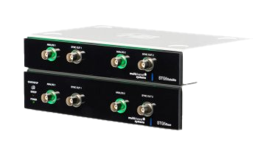
OTHER SOLUTIONS – Multichannelsystems STG5
MultiChannelSystems has a stimulator that can individually stimulate 2 channels (8 channels with add-ons) and send and receive external triggers
Why not this:
Not enough channels
Too expensive for even 8 channels!
Don’t necessarily need to be running multiple waveforms at one time for current EBS exploration.
This can be used in conjunction with the BRAINSBOARD

Slide 43
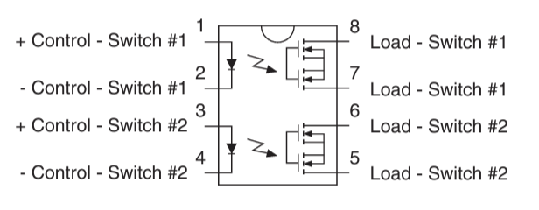
Answer 1: Solid State relays
How this works:
When a Control Switch receives power (pins 1 or 3, pins 2 and 4 are grounded), it powers an LED internally.
A photosensitive diode one the load switch side gets activated, closing the circuit allowing current to travel through the load switch from one side to the other.
This process allows the circuit to be galvanically isolated, preventing current to leak from the board parts and our Analog Isolated Stimulator.

Slide 44
Answer 1: Solid State relays
The board uses 24 of these, 16 individually linked to both the cathode and anode connection to our stimulator and 8 that connect our 16 pins to ground if we choose to ground those pins.
If none are activated, then our channel would be floating (if that is an option we want to pursue).
We can’t use MOSFETs or any semiconductor, the dynamic voltage would burn it out

Slide 45
Answer 1: Solid State relays
SSR Truth table
CONTROL | SWITCH STATE
L(0) or float | OFF
H(1) | ON

Slide 46
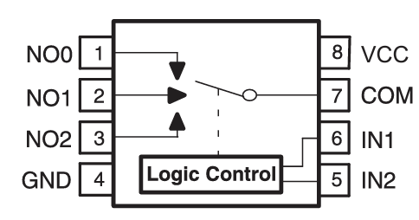
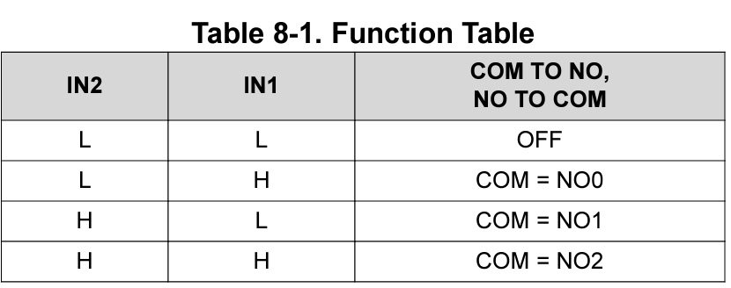
Answer 2: SP3T Switch
How this works:
First and foremost, there needs to be a VDD +5V connection as well as ground connected to the board
Next, there is the Two Inputs (A and B). This adjusts the path of our circuit to either receive current from RF1, RF2, or RF3. RF1 is our cathode, RF2, is our Anode, and RF3 is our ground
The output is from RFC, sent to our connector that connects to the pins

Slide 47
Answer 2: SP3T Switch
Connect NO0 to our Cathode
Connect NO1 to our Anode
Connect NO2 to our Ground
If this switch is off, this would lead to a floating pin

Slide 48
Answer 2: SP3T Switch
Logic is easy: Each switch (one for each of the 16 channels) requires 2 inputs, and 4 outputs are possible based on whether there is a High or Low signal at each pin
This ensures 1 of the 4 states is enabled at any time

Slide 49
Answer 3: D-type Latch
D
Q
Latch Enable (LE)
Output Enable (OE)

Slide 50
Answer 3: D-type Latch
Output Enable | Latch Enable | D | Q
High | ---- | ---- | Z (float)
Z is a high impedance state that allows nothing else through, no signal is sent anywhere in this state (hard stop of anything)

Slide 51
Answer 3: D-type Latch
Output Enable | Latch Enable | D | Q
High | ---- | ---- | Z (float)
Low | Low | ---- | Q_{t-1}
Q_{t-1} is the state that was previously enabled (that state is latched in)

Slide 52
Answer 3: D-type Latch
Output Enable | Latch Enable | D | Q
High | ---- | ---- | Z (float)
Low | Low | ---- | Q_{t-1}
Low | High | Low | Low
Our given D state is low while latch enable is on, so it changes the output state to low, no matter the previous state

Slide 53
Answer 3: D-type Latch
Output Enable | Latch Enable | D | Q
High | ---- | ---- | Z (float)
Low | Low | ---- | Q_{t-1}
Low | High | Low | Low
Low | High | High | High
Our given D state is High while latch enable is on, so it changes the output state to low, no matter the previous state

Slide 54
Answer 3: D-Type LAtch
Given this logic, we can set 32 different states to “High” or “Low” for our 16 SP3T switches
Issue at hand: we don’t want to use 32 pins

Slide 55
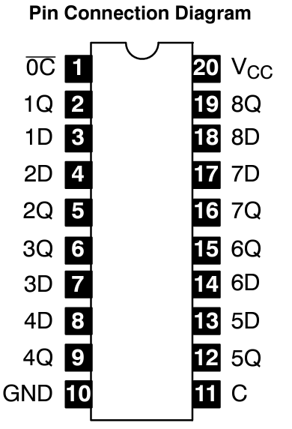
Answer 3: Octal transparent D-Type Latch
How this works:
There is the latch enable pin on each of these. Each individual part’s latch enable is connected to a pin on the Arduino/Raspberry Pi. Only when this pin is activated will the signal from our output change to high or low. This allows us to use the same 8 pins to control each board individually.
With 4 of these latches, we would only need one Output Enable pin, 4 Latch Enable pins, and 8 “D” Pins to get all our outputs

Slide 56
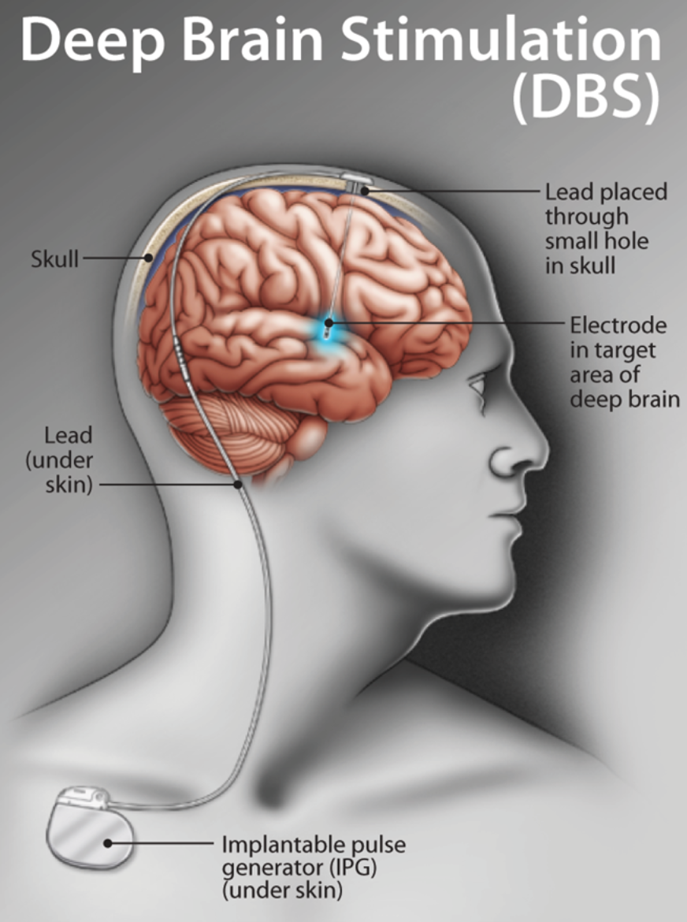
Background: Clinical Electrical Brain Stimulation
Current clinical uses
Movement disorders
Parkinson’s disease
Essential Tremor
Dystonia
Epilepsy
Mental health disorders
Obsessive Compulsive Disorder
Schizophrenia
Major Depressive Disorder
https://www.healthplexus.net/files/content/2017/0708/0708dbs_m1.png
Notes:
Don’t say primary use of EBS and crunch visual prosthesis slide into here
Capability to use multiple stimulation sites in clinical side, and they use them, but we don’t fully understand the biophysics of stimulating from single and multiple sites

Slide 57
Background: Multichannel Stimulation
Notes:
Need a concrete takeaway as to why we need a new device
BCI’s (don’t need A lot of outstanding questions about electrical brain stimulation devices
to talk about visual)

